Slide 1
EGE331 Computer Simulation
Course Instructor
Dr. Varad A. Karkhanis
Division of Engineering Programs
SUNY New Paltz
Spring 2020

Slide 2
Textbook
Essential MATLAB
for Engineers and Scientists
5th Edition
Brian H. Hahn
Daniel T. Valentine
No Need to buy! Class notes are Enough!

Slide 3
Course Syllabus
MATLAB Intro: arithmetic, variables, mathematical functions, important MATLAB commands
Linear Algebra: Vectors and Matrices, System of Algebraic Equations, MATLAB workspace, MATLAB operators, expressions and statements
MATLAB Loops: for loop, while loop, Vectorization, Conditional statements, Logical Vectors, Logical Operators and Truth Tables
MATLAB functions: Developing functions to accomplish dedicated tasks
Importing and Exporting data in text files
MATLAB graphics: 2D plots, 3D plots, Generating simple GUIs and animations
Introduction to Newton’s Method to solve nonlinear equations using MATLAB
Machine Learning in MATLAB environment: Introduction to Deep-Learning models in Machine Learning and Artificial Intelligence (AI)

Slide 4
Grading Policy
• Mid-term Exam-1 = 30%
• Homework assignments = 20%
• Project Presentation = 20%
• Term Project Report = 30% + Bonus points (for exceptional work)

Slide 5
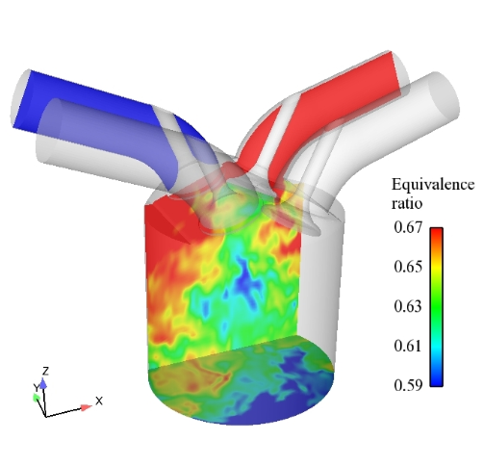
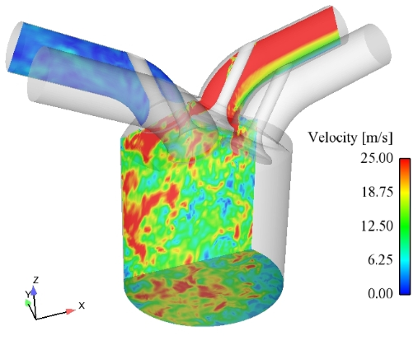
Computer Simulation
Example: Computational Fluid Dynamics (CFD) technique to simulate fluid flows
LES in a 4-valve piston engine
Authors(s): O. Vermorel- Credit: CERFACS and IFP

Slide 6
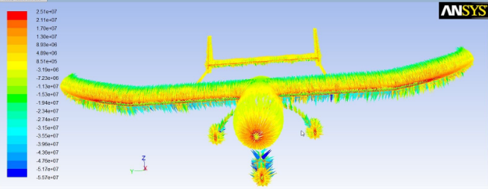
Computer Simulation
Velocity Vectors on the aircraft surface
Picture Courtesy: Ansys Software

Slide 7
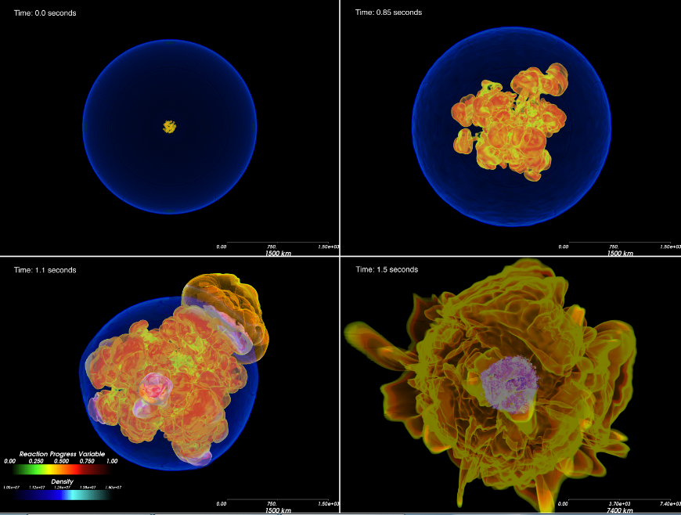
Supernova Detonation
Picture Courtesy:
http://flash.uchicago.edu/site/gallery/

Slide 8
MATLAB- Matrix Laboratory
5 6
3 7 8
4 9 10
A =
A(1,1) = ?
A(2,1) = ?
A(3,2) = ?
A(2,3) = ?

Slide 9
Computer Languages
Different Types of Languages
Assembly Language (Machine Specific) – Very Fast
Intel 8086 Assembly Language
Mac Assembly Language
Texas Instrument 320TMSC5515 Assembly Language (Fast)
Compiled Languages (Compiled, Machine Independent - Relatively fast)
(C, C++, JAVA, C#, Fortran)
Script Languages (Interpreted -
(MATLAB, PHP, CAD, etc.)

Slide 10
Write a simple computer program in C and MATLAB
Suppose you have $1000 saved in the bank. Interest is compounded at the rate of 9% per year. What will your bank balance be after one year?
1. Get the data (initial balance and interest rate) into the program.
2. Calculate the interest (9 per cent of $1000, i.e. $90).
Add the interest to the balance ($90 + $1000, i.e. $1090)
4. Display the new balance

Slide 11
Program in C
#include <stdio.h>
#include <stdlib.h>
int main(){
double interest, balance;
balance = 1000;
rate = 0.09;
interest = rate * balance;
balance = balance + interest;
printf(“balance=%d”, balance);
return 0;
}
~11 lines of code in C

Slide 12
Program in MATLAB
balance = 1000;
rate = 0.09;
interest = rate * balance;
balance = balance + interest;
disp( ’New balance:’ );
disp( balance );
~6 lines of code in MATLAB

Slide 13
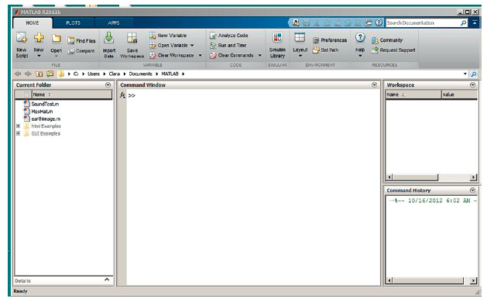
MATLAB Desktop

Slide 14
Integrated Development Environment (IDE)
q Command Window
q Current Directory
q Command History
q Workspace

Slide 15
MATLAB Commands
What is a MATLAB Command?
MATLAB is an interactive program. You can enter a command by typing it at the MATLAB prompt '>>' on the Command Window.
help | Searches for a help topic
clc | Clears command window
clear | Removes variables from memory
who | Lists current variables

Slide 16
Variables
What is a variable in a computer language?
In computer programming, a variable is a storage location paired with an associated symbolic name.

Slide 17
Examples
Type:
a = 5;
B = -1.2345;
Now look in Workspace to examine them.
Type:
c = 1:10;
B = [];
Now look in Workspace to examine them.

Slide 18
Examples
Type:
clear B;
What happens to the workspace?
Type:
clear

Slide 19
Variables in MATLAB
Variable name must comply with the following two rules:
1. It may consist only of the letters a–z, the digits 0–9 and the underscore ( _ ).
2. It must start with a letter.
Valid: r2d2, pay_day
Invalid: pay-day, 2a name$, _2a

Slide 20
Case sensitivity
Different variables:
balance, BALANCE and BaLance
Camel Caps:
camelCaps
milleniumBug
dayOfTheWeek
Commands are all in lower case

Slide 21
Examples of variables
interest=.09;
years=10;
delta=1.e-3;
email=‘doej@gmail.com’;
vect=[1 2 3 4 5];
matx=[1 2 3; 4 5 6];

Slide 22
Exercise
Create MATLAB variable names for the following, and assign them with random values:
Age of the student in the class
Number of students enrolled in the class

Slide 23
Workspace
who: lists the names of all the variables in your workspace
whos: lists the size of each variable as well
ans: returns the value of the last expression evaluated but
not assigned to a variable
Workspace

Slide 24
Exercise Using Command Window
Declare a “variable” to display your name in the command window and print it.
Write a program that declares two variables p, q. Initialize them with the values (+3) and (-5.4), respectively. Have your program to add, subtract, multiply and divide them.

Slide 25
Vectors in MATLAB
Initializing vectors: explicit lists
x = [1 3 0 -1 5] use spaces
a = [5,6,7] use commas
a = [1 2 3], b = [4 5], c = [a -b]
x = [ ]
Initializing vectors: the colon operator
x = 1:10
x = 1:0.5:4
x = 10:-1:1
x = 0:-2:-5
Explicitly providing elements to vectors!
Colon operator providing equi-spaced elements to vectors!

Slide 26
Vector Exercises
Initialize a vector (A) to have as its elements numbers 1 through 10 and another one (B) with integers -1 through -10.
B. Form vector C as the sum of the two vectors.
C. Form vector D as the concatenation of vectors A and B.

Slide 27
Array Index
r = [2, -2, 1, -4, 5, 1, 0]
This gives you a row vector of seven numbers.
r(3)
This will display the third element of r. The number 3 is the array index.
r(2:4)
This should give you the second, third and fourth elements.
r(1:2:7)
r([1 7 2 6]) elements located at specific indices are printed
r([1 7 2]) = [ ] will remove elements located at indices 1, 7 and 2

Slide 28
Array Subscripts (Exercises)
Form vector A made of even numbers between 0 and 12.
Add the first and the last elements of a vector and call it sum1.
Find sum2 as the sum of the first 4 elements of a vector.
Form a new vector B that is made of the last 4 elements of A.

Slide 29
Matrices
a = [1 2 3; 4 5 6] = 1 2 3
4 5 6
a’ = 1 4
2 5
3 6
A matrix can be constructed from column vectors of the same lengths:
x = 0:30:180;
table = [x’ sin(x*pi/180)’] = 0.0000 0.0000
30.0000 0.5000
60.0000 0.8660
90.0000 1.0000
120.0000 0.8660
150.0000 0.5000
180.0000 0.0000

